Slide 1
Tree

Slide 2
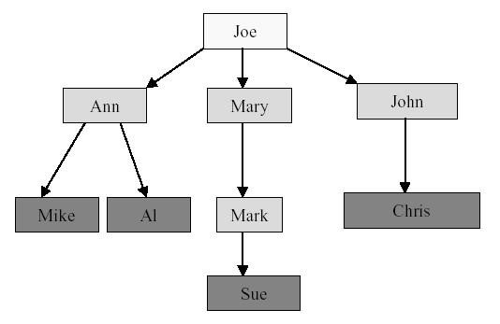
Depth and Height
Depth: The depth of a node in the tree is the length of the path from the root to that node.
Height : Height of the tree is equal to the depth of the deepest leaf.
Height of tree is maximum level of any node in a tree
root->child[i]->ch_count
root->child[i]->child[j]->label

Slide 3
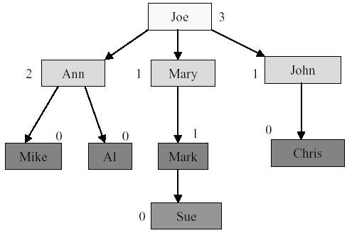
Node Degree
Node degree: The number of children of a node

Slide 4
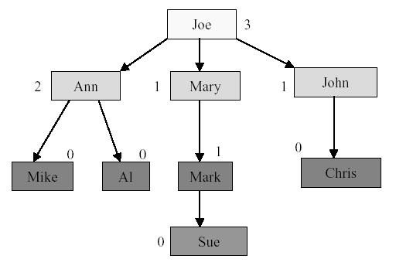
Tree Degree
Tree Degree: determined by the node with the highest degree
Tree Degree = 3

Slide 5
Binary Tree
A binary tree is a tree in which no node can have more than two subtrees.
A node can have 0,1 or 2 subtrees
These subtrees are designated as left and right subtrees of the binary tree
A
Left Subtree
Right Subtree
B
C
D
E
F

Slide 6
Binary Tree
Binary Tree- ordered tree with all nodes having at the most 2 children
Recursive Definition:
A binary tree is either
a empty tree or
consists of a node , called a root and two children, left and right, each of which are themselves binary trees.
Ordered Tree is one in which the children of each node are ordered

Slide 7
Sample Binary Trees
A
A
A
B
B
A
C
B
C

Slide 8
Difference Between a Tree & a Binary Tree
A binary tree may be empty; a tree cannot be empty.
No node in a binary tree may have a degree more than 2, whereas there is no limit on the degree of a node in a tree.
The subtrees of a binary tree are ordered; those of a tree are not ordered

Slide 9
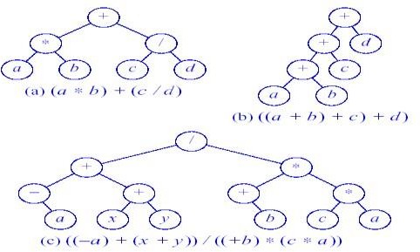
Binary Tree for Expressions

Slide 10
Types of Binary Trees
Full Binary Tree
Strictly Binary Tree
Complete Binary Tree
Almost Complete Binary Tree
Skewed Binary Tree

Slide 11
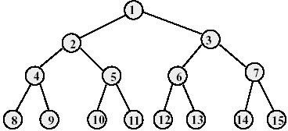
Full Binary Tree
A full binary tree of height h has exactly 2^{h}-1 nodes. (root at level 1)
Numbering the nodes in a full binary tree
Number the nodes 1 through 2^{h}-1
Number by levels from top to bottom
Within a level, number from left to right

Slide 12
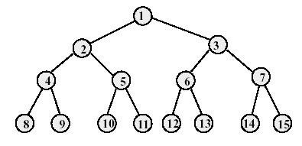
Node Number Property of Full Binary Tree
Parent of node i is node (i/2) , unless i = 1
Right child of node i is node 2i+1,
Left child of node i is node 2i,
If 2i+1 > n, node i has no right child and if 2i > n, node i has no left child , where n is the total number of nodes.

Slide 13
Strictly Binary Tree
If every non leaf node in binary tree has non empty left and right subtree, the tree is termed as Strictly Binary Tree
Strictly Binary Tree Not Strictly Binary Tree
A
A
B
C
B
C
D
E
F
D
E
G
H
I
F
G

Slide 14
Complete Binary Tree
A complete binary tree of depth d is the strictly binary tree whose all leaves are at level d.
Since all leaf nodes in such tree are at level d, the tree contains 2^{d} leaf nodes and 2 ^{d} -1 non leaf nodes
A
B
C
D
E
F
G

Slide 15
Almost complete binary tree
A binary tree of depth d is an almost complete binary tree if:
Any node nd at level than d-1 has two children
2. For any node nd in the tree with right descendant at level d, nd must have left child and every left descendant of nd is either a leaf at level d or has two children.

Slide 16
Converting tree to a binary tree
There is one to one mapping between general tree and binary tree.
So every tree can be uniquely represented by a binary tree.
Conversion from general tree to binary tree can be done in two stages:
Stage 1:
1. As first step, we delete all the branches originating from every node except the left most branch.
2. We draw branches from the left most node to its siblings on right if any.
Stage 2: For any particular node we choose left and right child as:
The left child is a node, which is immediately below the given node and the right child is the child is the node connected on the same level.

Slide 17
Converting to a Binary Tree
A
Binary tree left child = leftmost child
•
Binary tree right child= right sibling
B
•
C
D
A
F
E
B
C
D
E
G H
I
F
G
H
J
I
J

Slide 18
A
A
B
C
D
E
B
F
G
H
C
I
J
D
A
F
E
B
C
D
E
G
H
F
G
H
I
I
J
J

Slide 19
Tree Representation
Using Array
Using Linked List

Slide 20
Tree Representation: Using Array
In array representation of a binary tree, we use one-dimensional array (1-D Array) to represent a binary tree.
To represent a binary tree of depth 'n' using array representation, we need one dimensional array with a maximum size of 2n + 1.

Slide 21
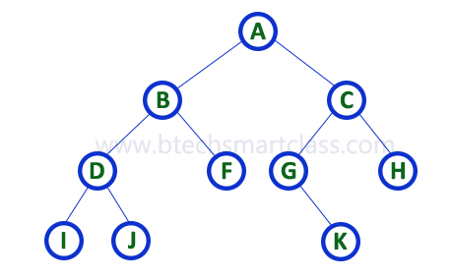
Tree Representation: Using Array

Slide 22

Tree Representation: Using Linked List
We use a double linked list to represent a binary tree.
In a double linked list, every node consists of three fields.
First field for storing left child address, second for storing actual data and third for storing right child address.

Slide 23
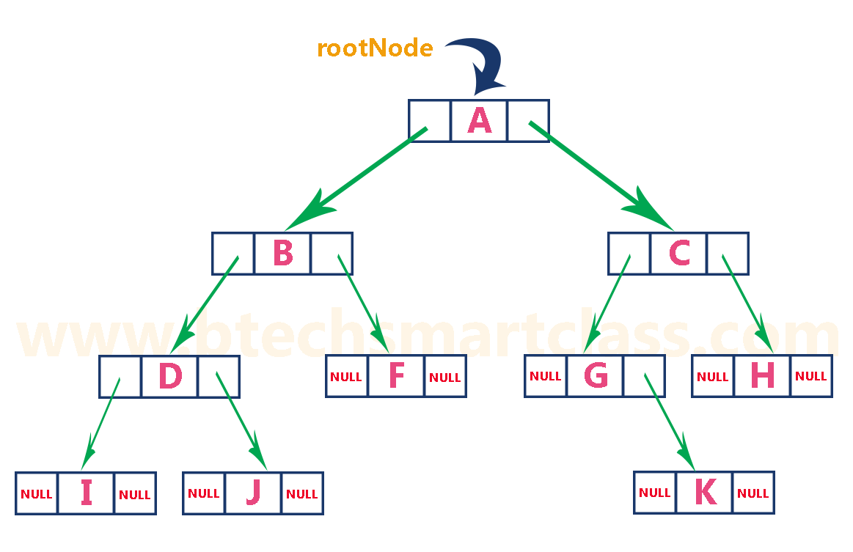
Tree Representation: Using Linked List

Slide 24
Binary Tree Traversals
To display a binary tree, we need to follow some order in which all the nodes of that binary tree must be displayed.
In any binary tree, displaying order of nodes depends on the traversal method.
Depth First Traversal : process all descendents of a child before going on to the next child.
In - Order Traversal
Pre - Order Traversal
Post - Order Traversal
Breadth First Traversal : each level is completely processed before the next level is started.
Level order

Slide 25
Binary Tree Traversals
In - Order Traversal : The root node is visited between the left child and right child.
In this traversal, the left child node is visited first, then the root node is visited and later we go for visiting the right child node.
This in-order traversal is applicable for every root node of all subtrees in the tree.
This is performed recursively for all nodes in the tree.

Slide 26
In - Order Traversal
Algorithm Inorder(tree)
1. Traverse the left subtree, i.e., call Inorder(left-subtree)
2. Visit the root.
3. Traverse the right subtree, i.e., call Inorder(right-subtree)

Slide 27
Recursive Inorder Traversal
Algorithm inorder( root)
If(root is not null)
1. inorder(Root ->LeftSubtree);
2. print (root)
3. inorder(Root->RightSubtree);
End if

Slide 28
Non Recursive Inorder traversal
1) Create an empty stack S.
2) Initialize current node as root
3) Push the current node to S and
set current = current->left until current is NULL
4) If current is NULL and stack is not empty then
a) Pop the top item from stack.
b) Print the popped item, set current = popped_item->right
c) Go to step 3.
5) If current is NULL and stack is empty then we are done.

Slide 29
Example
Root/Current
Stack
10
8
11
7
9

Slide 30
Example
10
Push 10 onto stack and move onto left branch
current = current->left
10
Root/Current
8
11
7
9

Slide 31
Example
10
Push 8 onto stack and move onto left branch
current = current->left
8
10
8
11
Root/Current
7
9

Slide 32
Example
10
Push 7 onto stack and move onto left branch
current = current->left
7
8
10
8
11
7
9
Root/Current = NULL

Slide 33
Example
As current==NULL we will pop stack and print the element.
Then move
current = current->right
10
8
10
8
11
Output: 7
7
9
Root/Current = NULL

Slide 34
Example
As new current is also equals to NULL , we will again pop stack and print the element.
Now new current= popped elements right child
i.e. 9
10
10
8
11
Output: 7 ,8
7
9
Root/Current = NULL

Slide 35
Example
As new current is also equals to NULL , we will again pop stack and print the element.
Now new current= popped elements right child
i.e. 9
10
10
8
11
Output: 7 ,8
7
9
Root/Current = 9

Slide 36
Example
Push current onto stack
And current=current->left
10
9
10
8
11
Output: 7 ,8
7
9
Root/Current = NULL

Slide 37
Example
As current== Null
Pop stack
And current=current->right
10
9
10
8
11
Output: 7 ,8,9
7
9
Root/Current = NULL

Slide 38
Example
As current== Null
Pop stack
And current=current->right
10
10
8
11
Output: 7 ,8,9
7
9
Root/Current = NULL

Slide 39
Example
As current== Null
Pop stack
current=popped elemets right child
i.e. 11
10
8
11
Output: 7 ,8,9,10
7
9
Root/Current = NULL

Slide 40
Example
As current== Null
Pop stack
current=popped elements right child
i.e. 11
10
8
11
Output: 7 ,8,9,10
7
9
Root/Current=NULL

Slide 41
Example
Push current on stack.
current=current->left child
10
11
8
11
Output: 7 ,8,9,10
Root/Current
7
9

Slide 42
Example
As current== Null
Pop stack
10
8
11
Output: 7 ,8,9,10,11
7
9
Root/Current=NULL

Slide 43
Binary Tree Traversals
Pre - Order Traversal : The root node is visited before the left child and right child.
In this traversal, the root node is visited first, then the left node is visited and later we go for visiting the right child node.
This pre-order traversal is applicable for every root node of all subtrees in the tree.
This is performed recursively for all nodes in the tree.

Slide 44
Pre- Order Traversal
Algorithm Preorder(tree)
1. Visit the root.
2.Traverse the left subtree, i.e., call Preorder(left-subtree)
3. Traverse the right subtree, i.e., call Preorder(right-subtree)

Slide 45
Recursive Preorder Traversal
Algorithm preorder( root)
If(root is not null)
1. print (root)
2. preorder(Root ->LeftSubtree);
3. preorder(Root->RightSubtree);
End if

Slide 46
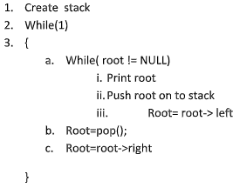
Non Recursive Preorder Traversal
1) Create an empty stack nodeStack and push root node to stack.
2) Do following while nodeStack is not empty
….a) Pop an item from stack and print it.
….b) Push right child of popped item to stack
….c) Push left child of popped item to stack
Right child is pushed before left child to make sure that left subtree is processed first.

Slide 47
Binary Tree Traversals
Post - Order Traversal : The root node is visited after the left and right child node..
In this traversal, the left child node is visited first, then the right child node is visited and later we go for visiting the root node.
This post-order traversal is applicable for every root node of all subtrees in the tree.
This is performed recursively for all nodes in the tree.

Slide 48
Post- Order Traversal
Algorithm Postorder(tree)
1. Traverse the left subtree, i.e., call Postorder(left-subtree)
2. Traverse the right subtree, i.e., call Postorder(right-subtree)
3. Visit the root.

Slide 49
Recursive Postorder Traversal
Algorithm postorder( root)
If(root is not null)
1. postorder(Root ->LeftSubtree);
2. postorder(Root->RightSubtree);
3. print (root)
End if

Slide 50
Non Recursive Postorder Traversal
1.1 Create an empty stack
2.1 Do while root is not NULL
a) Push root's right child and then root to stack.
b) Set root as root's left child.
2.2 Pop an item from stack and set it as root.
a) If the popped item has a right child and the right child is at top of stack, then remove the right child from stack, push the root back and set root as root's right child.
b) Else print root's data and set root as NULL.
2.3 Repeat steps 2.1 and 2.2 while stack is not empty.

Slide 51
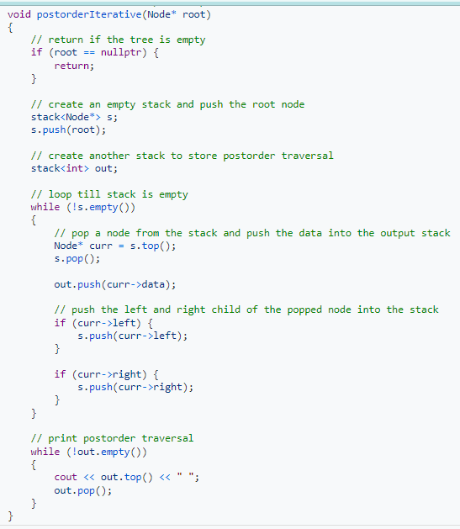

Slide 52
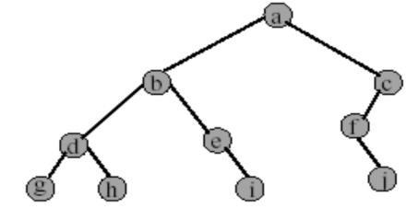
Print inorder, Preorder and Postorder traversal for given tree.
g h d i e b J f c a

Slide 53
Binary Tree Construction
• Inoder: B C A E D G H F I
• Preoder: A B C D E F G H I
A
B,C
D, E, F, G, H, I
A
B
D, E, F, G, H, I
C

Slide 54
Binary Tree Construction
• Inoder: B C A E D G H F I
• Preoder: A B C D E F G H I
A
B
D,
C
E
F, G, H, I

Slide 55
Binary Tree Construction
• Inoder: B C A E D G H F I
• Preoder: A B C D E F G H I
A
B
D,
C
E
F
G,H
I

Slide 56
Binary Tree Construction
• Infix: B C A E D G H F I
• Prefix: A B C D E F G H I
A
B
D,
C
E
F
G
I
H

Slide 57
Binary Search Tree
Definition: A binary tree where every node's left sub-tree has values less than the node's value, and every right sub-tree has values greater than the node's value
Binary search tree is a Binary Tree with following Properties:
All items in the left subtrees are less than the root.
All items in the right subtrees are greater than root
Each subtreee is itself a BST.

Slide 58
Binary Search Tree
Key
All < Key
Key < All

Slide 59
Binary Search Trees (BST) Operations
Insertion
Deletion
Traversals
Search

Slide 60
BST Operations - Insertion
Case 1: The Tree is Empty
Set the root to a new node containing the item
Case 2: The Tree is Not Empty
Call a recursive helper method to insert the item

Slide 61
BST Operations - Insertion
Algorithm:
Read the value for which node to be created, and store it in node called New.
If(root== NULL) then(root=New)
If( New->data < root-> data)
Attach New node as left child Otherwise attach New node as a right child.
Repeat step 3 for constructing binary search tree completely.

Slide 62
BST Operations - Insertion
Void Binarytree::insert(node *root, node *New)
{
if(root== NULL)
root=New;
if(New->data < root->data)
{
if(root->left ==NULL)
root->left=New
else
insert(root->left, New);
}
if(root->data < New->data)
{
if(root->right ==NULL)
root->right=New
else
insert(root->right, New);
}
}

Slide 63
BST Operations - Search
Algorithm SearchBST (root, target)
1. If (empty tree) /*Not found target
return(null)
2. end if
3. If ( target < root)
return SearchBST (left subtree, target)
4. else if ( target > root)
return SearchBST (right subtree, target)
5. else
return root
6. end if
end SearchBST

Slide 64
BST Operations : Deletion
First locate the node which is to be deleted.
The node to be deleted has
1. No children
2. Only a right subtree
3. Only left subtree
4. Two subtrees

Slide 65
BST Operations : Deletion
Case | The node to be deleted has- | Action
1. | No children | Delete the node
2. | Only a right subtree | Delete the node and attach the right subtree to the deleted node’s parent
3. | Only left subtree | Delete the node and attach the left subtree to the deleted node’s parent
4. | Two subtrees | Possible to delete the node from the middle

Slide 66
BST Operations : Deletion
Result tends to create very unbalanced trees
Therefore try to maintain existing structure as much as possible.
Can be done in one of two ways-
1. Find the largest node in the deleted node’s left subtree and move its data to replace the deleted node’s data.
2. Find the smallest node in the deleted node’s right subtree and move its data to replace the deleted node’s data

Slide 67
Delete node from BST
Pseudocode
1. if the tree is empty return false
1. Attempt to locate the node containing the target
if the target is not found return false
else the target is found, so remove its node:
Case 1: if the node has 2 empty subtrees replace the link in the parent with null.

Slide 68















Delete node from BST : Example Case 1: 50
50
Delete Node 60
20
70
10
40
80
60
30
100

Slide 69
Delete node from BST : Example Case 1: 50
50
Delete Node 60
20
70
10
40
80
30
100

Slide 70
Delete node from BST
Pseudocode
1. if the tree is empty return false
1. Attempt to locate the node containing the target
if the target is not found return false
else the target is found, so remove its node:
Case 2: if the node has no right child, link the parent of the target to the left (non-empty) subtree

Slide 71
Delete node from BST : Example Case 2: 50
50
Delete Node 40
20
70
10
40
80
60
30
100

Slide 72
Delete node from BST : Example Case 2: 50
50
Delete Node 40
20
70
10
30
80
60
100

Slide 73
Delete node from BST
Pseudocode
1. if the tree is empty return false
1. Attempt to locate the node containing the target
if the target is not found return false
else the target is found, so remove its node:
Case 3: if the node has no left child, link the parent of the target to the right (non-empty) subtree

Slide 74
Delete node from BST : Example Case 3: 50
50
Delete Node 40
20
70
10
40
80
60
48
100

Slide 75
Delete node from BST : Example Case 3: 50
50
Delete Node 40
20
70
10
48
80
60
100

Slide 76
Delete node from BST
Pseudocode
1. if the tree is empty return false
1. Attempt to locate the node containing the target
if the target is not found return false
else the target is found, so remove its node:
Case 4: if the node has a left and a right subtree
- replace the node's value with the max value in the left subtree
- delete the max node in the left subtree

Slide 77
Delete node from BST : Example Case 4: 50
50
Delete Node 40
20
70
10
40
80
60
30
48
100

Slide 78
Delete node from BST : Example Case 4: 50
50
Delete Node 40
20
70
10
30
80
60
48
100

Slide 79
Delete node from BST
Algorithm deleteBST(root, dltkey)
If dltkeynot found, root unchanged Return true if node deleted,false if not found.
1. If (empty tree)
return false(Null)
2. end if
3. If (dltkey <root)
return deleteBST(left subtree, dltkey)
4. Else if (dltkey> root)
return deleteBST(right subtree, dltkey)
5. else
delete node found-test for leaf node
1. If ( no left subtree)
1. Make right subtree the root
2. return true
2. else if (no right subtree)
1. Make left subtree the root
2. return true
3. else
node to be deleted - not a leaf
Find largest node on left subtree
1. save root in deleteNode
2. set largest to largestBST( left subtree)
3. move data in largest to deleteNode
4. return deleteBST(left subtree of deleteNode, key of largest) 4.end if 6. end if
end deleteBST

Slide 80
Threaded Binary Tree
When binary tree represented using Linked List
Number of nodes: n
Total links: 2n
Number of non-null links: n-1
Null links: 2n- (n-1) = n+1
Too many null pointers in current representation of binary trees

Slide 81
Threaded Binary Tree
Links of Leaf nodes point to NULL, which are of no use while traversing the tree
In Threaded Binary tree, these null links are converted to point to some valid node from the tree itself.
Null links can be used to point some other nodes in the tree.
➢ Left Link points to its immediate predecessor
➢ Right Link points to its immediate successor
Replace these null pointers with some useful “threads”.

Slide 82
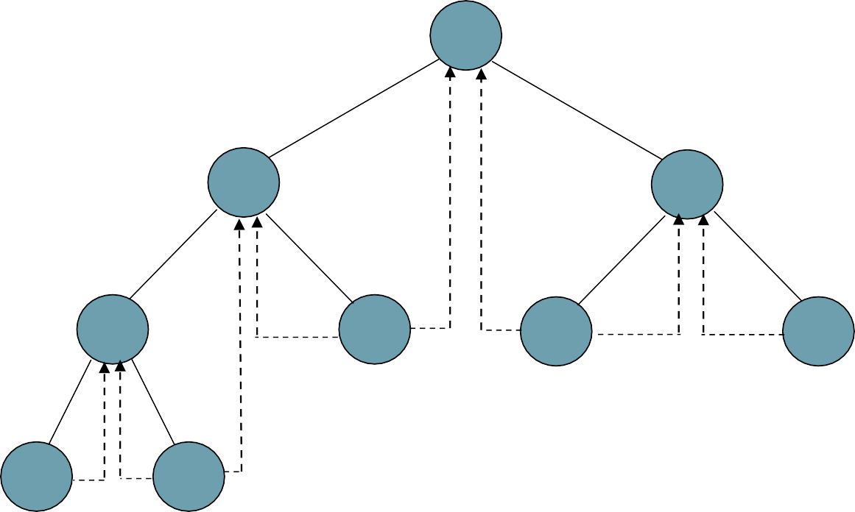
Threaded Binary Tree
Thread:
The Link that points to a node , other than its children is called a thread .
Thread represented by dotted line
We need to know if a pointer is an actual link or a thread, so we keep a boolean for each pointer
A
B
C
D
E
F
G
H
I

Slide 83
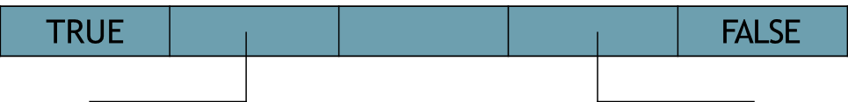
Threaded Binary Tree
To distinguish between normal pointers and threads, two boolean fields, LeftThread and RightThread, are added to the record in memory representation.
t->LeftChild = TRUE => t->LeftChild is a thread
t->LeftChild = FALSE => t->LeftChild is a pointer to the left child.
t->RightChild = TRUE => t->RightChild is a thread
t->RightChild = FALSE => t->RightChild is a pointer to the right child.
LeftThread
LeftChild
data
RightChild
RightThread

Slide 84
Threaded Binary Tree
If node is having empty left subtree then its left pointer will point to inorder predecessor in the tree.
If node is having empty right subtree then its left pointer will point to inorder successor in the tree.

Slide 85
Data Structures for Threaded BT
struct threaded_tree
{
int left_thread;
int right_thread;
threaded_tree *left_child;
int data;
threaded_tree * right_child;
};

Slide 86
Insertion of a Node into TBT
Insert node R as the right child of a node S
Case 1: Node S does not have a right child
The RC pointer which points to in-order successor (z) is made to point to R
No Right Child means RT=1
Then RT changed from 1 -> 0
RT of S:0 and RT of R:1

Slide 87
TBT Insertion Case 1: Node S does not have a right child
s
S
R
R

Slide 88
Inserting a node as the right child in TBT
Void ThreadedTree :: InsertRight(ThreadedNode *s, ThreadedNode *r)
//Insert r as the right child of s
{ r → RightChild = s → RightChild;
r → RightThread = s → RightThread;
r → LeftChild = s;
r → LeftThread = 1;
s → RightChild = r;
s → RightThread = 0;
if(! r → RightThread)
{
ThreadedNode *temp = InorderSucc( r );
temp → LeftChild = r;
}
}

Slide 89
Delete Node from TBT
Similar to deleting Node from BST with adjustment in threads
Consider all three possibilities :
➢Delete Leaf Node
➢Delete Internal Node
➢Delete Leaf Like Node (Having either Left or Right
Subtree)

Slide 90
Inorder Traversals of TBT
Algorithm:
1. Traverse to the leftmost child
2. Read it
3. If it has a right child
4. Go to step 1 with respect to right child
5. Read the in-order successor using thread
6. If it has a right child
7. Go to step 1 with respect to right child
8. If in-order successor points to root
9. Exit
10. Go to step 5 (else)

